Slide 1
Discrete Mathematics (CSC 1204)
Chapter 8
8.1 Graphs and Graph Models
8.2 Graph Terminology and Special Types of Graphs

Slide 2
What is a Graph?
Definition1: A graph G = (V,E) consists of V, a nonempty set of vertices (or nodes) and E, a set of edges.
Each edge has either one or two vertices associated with it, called its end points.
An edge is said to connect its endpoints.
Note: The set of vertices V of a graph may be infinite. A graph with an infinite vertex set is called an infinite graph. A graph with a finite vertex set is called a finite graph. [We will consider only finite graphs]

Slide 3
Graph Terminology : Different Types of Graphs
Simple Graph: An undirected graph with no multiple edges or loops is called a simple graph.
Multigraph: An undirected graph that may contain multiple edges connecting the same vertices but no loops.
Pseudograph: An undirected graph that may contain multiple edges and loops is called a pseudograph.

Slide 4
Graph Terminology : Different Types of Graphs
Simple Directed graph: When a directed graph has no loops and has no multiple directed edges, it is called a simple directed graph.
Directed multigraph: A graph with directed edges that may contain multiple directed edges is called a directed multigraph.
Mixed Graph: A graph with both directed and undirected edges is called a mixed graph. A mixed graph may contain loop(s).
Loop: An edge that connect a vertex to itself is called a loop.

Slide 5
Table 1: Graph Terminology
Type | Edges | Multiple Edges Allowed? | Loops Allowed?
Simple graph | Undirected | No | No
Multigraph | Undirected | Yes | No
Pseudograph | Undirected | Yes | Yes
Simple directed graph | Directed | No | No
Directed Multigraph | Directed | Yes | Yes
Mixed graph | Directed and Undirected | Yes | Yes

Slide 6
Directed Graph
Definition 2: A directed graph(or digraph) (V,E) consists of a nonempty set of vertices V and a set of directed edges E.
Each directed edge is associated with an ordered pair of vertices.
The directed edge associated with the ordered pair (u,v) is said to start at u and end at v.

Slide 7
8.2 Graph Terminology and Special Types of Graphs
Basic terminology
Adjacent vertices
Degree of a vertex
In-degree of a vertex
Out-degree of a vertex
Isolated vertex
Pendant vertex
The Handshaking Theorem
Some Special Simple Graphs
Bipartite Graphs

Slide 8
Basic Terminology
Definition1: Two vertices u and v in an undirected graph G are called adjacent (or neighbors) in G if u and v are endpoints of an edge of G.
If e is associated with {u, v}, the edge e is called incident with the vertices u and v.
The edge e is also said to connect u and v.
The vertices u and v are called endpoints of an edge associated with {u, v}.

Slide 9
Basic Terminology
Definition 3: The degree of a vertex in an undirected graph is the number of edges incident with it, except that a loop at a vertex contributes twice to the degree of that vertex.
The degree of the vertex v is denoted by deg(v)
Isolated vertex: A vertex of degree zero is called isolated.
Pendant vertex: A vertex is pendant if and only if it has degree one.

Slide 10
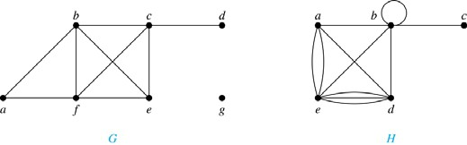
Example 1
Example 1 : What are the degrees of the vertices in the graphs G and H?
Solution:
G: deg(a) = 2, deg(b) = deg(c)= deg(f)=4, deg(d)=1, deg(e) = 3, and deg(g)= 0
H: deg(a) = 4, deg(b) = deg(e) = 6, deg(c) = 1, deg(d) = 5.

Slide 11
The Handshaking Theorem
Theorem 1 (The Handshaking Theorem):
Let G = (V,E) be an undirected graph with e edges. Then
2e =
deg(v)
Note: This applies even if multiple edges and loops are present

Slide 12
Example 2
Example 2: How many edges are there in a graph with 10 vertices each of degree six?
Solution: Because the sum of the degrees of the vertices is 6.10 = 60, it follows that 2e=60.
Therefore, e = 30

Slide 13
Theorem 2
Theorem 2: An undirected graph has an even number of vertices of odd degree.
Example: If a graph has 5 vertices, can each vertex have degree 3?
Solution: This is not possible by the Handshaking theorem, because the sum of the degrees of the vertices 3.5 = 15 is odd.

Slide 14
Initial vertex & Terminal Vertex
Definition 3: When (u, v) is an edge of the graph G with directed edges, u is said to be adjacent to v and v is said to be adjacent from u.
The vertex u is called the initial vertex of (u, v) and
v is called the terminal/end vertex of (u, v).
Note: The initial vertex and terminal vertex of a loop are the same.

Slide 15
In-degree & Out-degree of a vertex
Definition 4: In a graph with directed edges the
in-degree of a vertex v, denoted by deg–(v), is the number of edges with v as their terminal vertex.
The out-degree of v, denoted by deg⁺(v), is the number of edges with v as their initial vertex.
Note: A loop at a vertex contributes 1 to both the
in-degree and the out-degree of this vertex.

Slide 16
Example: In-degree & Out-degree of a vertex
Question: What are in-degrees and out-degrees of all the vertices in the graph below?
2
1
3

Slide 17
Example: In-degree & Out-degree of a vertex
Solution:
deg⁻(1) = 0
deg⁻(2) = 3
deg⁻(3) = 4
deg⁺(1) = 2
deg⁺(2) = 3
deg⁺(3) = 2
Practice Yourself: Example 4
2
1
3

Slide 18
Theorem 3
Theorem 3: Let G = ( V, E ) be a graph with directed edges. Then
➔ Handshaking Theorem for directed graph
deg–(v) =
deg⁺(v) = |E|

Slide 19
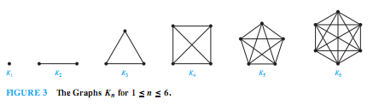
Some Special Simple Graphs: Complete Graph(K_{n})
The complete graph on n vertices, denoted by K_{n}, is the simple graph that contains exactly one edge between each pair of distinct vertices.
The graph , for n = 1, 2, 3, 4, 5, 6 are displayed in the following figure:

Slide 20
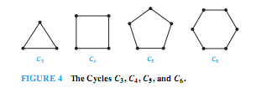
Some Special Simple Graphs: Cycles(C_{n})
The Cycle C_{n}, n>=3, consists of n vertices v₁, v₂, ….v_{n} and edges {v_{1 ,} v₂ }, {v₂, v₃}, …. {v_{n-1}, v_{n} }, and {v_{n}, v₁ }
The cycles for C₃ , C₄ , C₅ , and C₆ are displayed in the following figure:

Slide 21
Some Special Simple Graphs: Wheels(W_{n})
We obtain the Wheel (W_{n}) when we add an additional vertex to the Cycle C_{n} , for n>=3, and connect this new vertex to each of the n vertices in C_{n} , by new edges.
The wheel W_{n} is just a cycle graph with an extra vertex in the middle
The Wheels W₃ , W₄ , W₅ are displayed in the figure below:

Slide 22
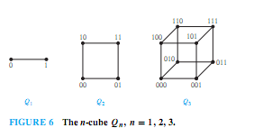
Some Special Simple Graphs: n-Cubes(Q_{n})
The n-dimensional hypercube, or n-cube, denoted by Q_{n}, is the graph that has vertices representing the 2^{n} bit strings of length n.
Two vertices are adjacent iff the bit strings that they represent differ in exactly one bit position.
The graphs Q₁, Q₂ , and Q₃are displayed in the following figure:

Slide 23
Bipartite graphs
Definition 5: A simple graph G is called bipartite if its vertex set V can be partitioned into two disjoint sets V₁ and V₂ such that every edge in the graph connects a vertex in V₁ and a vertex in V₂
Note: If each vertex of V₁ is connected to each vertex of V₂, then it is called complete bipartite graph and it is denoted by K_{m,n} where m is the number of vertices in V₁ and n is the number of vertices in V₂

Slide 24
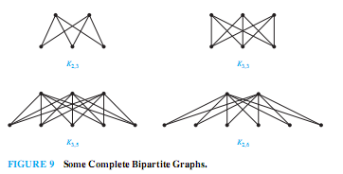
Bipartite graphs

Slide 25
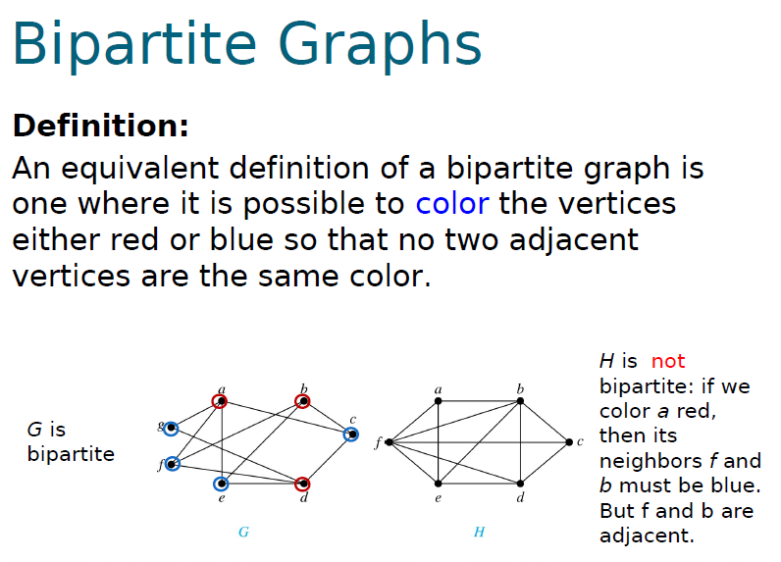
Example 11: Are the graphs G and H are Bipartite?

Slide 26
Practice @ Home
Relevant Odd-Numbered exercises

